Slide 3




Bosco López
MICROSOFT - Product Marketing Manager Project y Visio
@Boscolg
Vicente Rubio
MICROSOFT - Consultor Project y Visio
@vicenterubio

Slide 4
Roadmap de Project

Slide 5




Our Vision
Portfolio
Management
PMO/Executives
Project Teams
Project
Management
Work
Management
Ad hoc Teams
Task
Management
Individuals
Complexity

Slide 6

Smart transformation is key
58%
Alignment
71%
of projects
are not highly aligned to strategy
Of well
aligned projects completed
— PMI
— PMI
14x
Execution
89%
21%
Collaboration
66%
More investments
at risk
Of projects successful in high-performing companies
Loss in productivity due to collaboration challenges
Of CIOs see collaboration as key to driving innovation
— PMI
— PMI
— IDC
— McKinsey

Slide 7





Microsoft philosophy
A comprehensive set of tools delivered to almost any device through cloud or on-premise
Comprehensive Toolset
Devices
Cloud and On-Premise

Slide 8
Project en la Nube
Project Lite
Project Online
Project Pro para Office 365
Project Online con Project Pro para Office 365
Audiencia
Miembros del Equipo
Gerente de carteras, Ejecutivos, Gerente de recursos
Gerentes de proyecto
Gerentes de proyectos empresariales
Punto Final
Explorador Web
Explorador Web
Cliente
Explorador Web y Cliente
Capacidades Clave
Tareas
Hoja de horas
Colaboración
Tareas
Hoja de horas
Colaboración
Administración de carteras
Administración de demanda
Administración financiera
Informes de carteras e Inteligencia de negocios
Integración LOB
Programación del proyecto
Costo del proyecto
Asignación de recursos
Planificador del equipo
Diagrama de red
Programación automática
Presencia de Lync
Sincronización con Project Online
Capacidades tanto de Project Online como de Project Pro para Office 365

Slide 9



Project and Portfolio Management
Alignment
Execution
Collaboration
Business objectives prioritization
Demand Management
Portfolio Optimization
Portfolio Governance
Portfolio Reports
Scheduling
Resource Management
Risk Management
Timesheeting
Project Reporting
File sharing
Social communications
Document co-authoring
Team sites
Voice and video calls

Slide 10

Project Roadmap

Slide 11







A strong decade of investments and innovations
Consistency with Office
Resource Management
Consolidated PPM Solution
PPM in the Cloud
OData
support in SSIS
Delta Updates in SSIS
Multiple
scalability enhancements
011001
011010
101001
2003
2007
2010
2013
2014
1H
2014
2H
2015
1H

Slide 12


Key Investment Pillars
Desktop Enhancements
Resource Management
IT Value
More fluent UI
Multiple timelines
App Write back
Resource Engagement
Capacity Planning
Email notifications
Database consolidation
Reporting
Integration with TFS
Project

Slide 13

Desktop Enhancements
Project

Slide 14
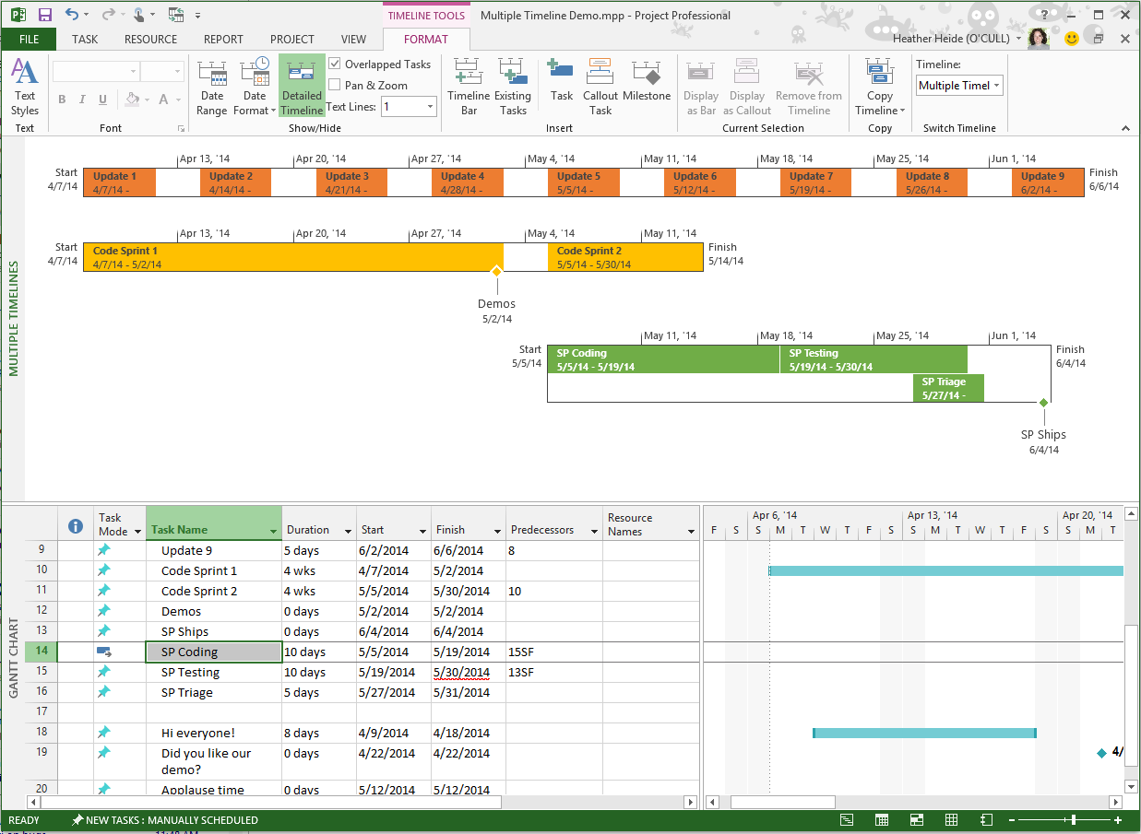

Desktop Enhancements
View multiple timeline bars, each representing a set range in a single view
Contoso Design – New Ad Campaign – Project Professional
Kat Larsson
Multiple Timelines

Slide 15
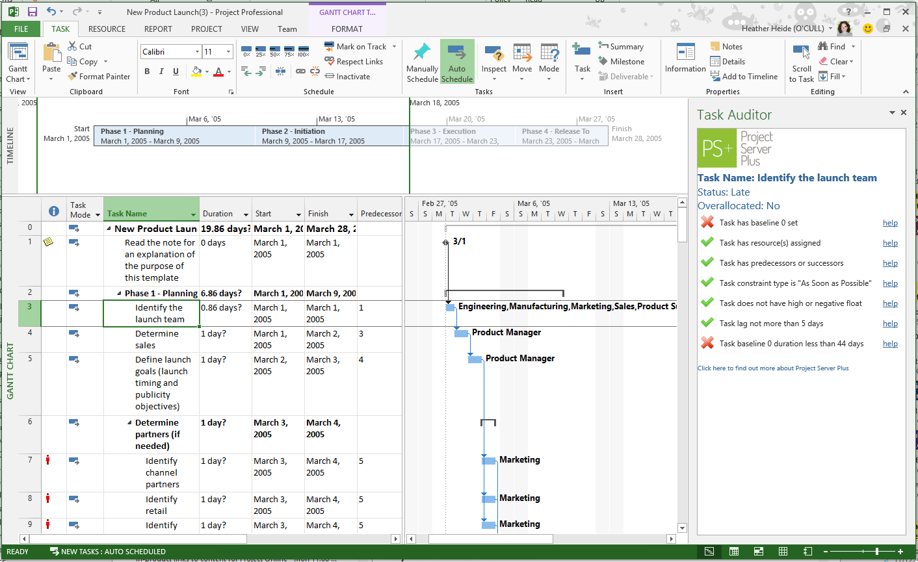

Desktop Enhancements
Apps for Project Desktop client can write back to the Plan
Contoso Design – New Ad Campaign – Project Professional
Kat Larsson
Plan Analyzer
C
Contoso
Corp
App Write Back

Slide 16

Resource Management
Project

Slide 17
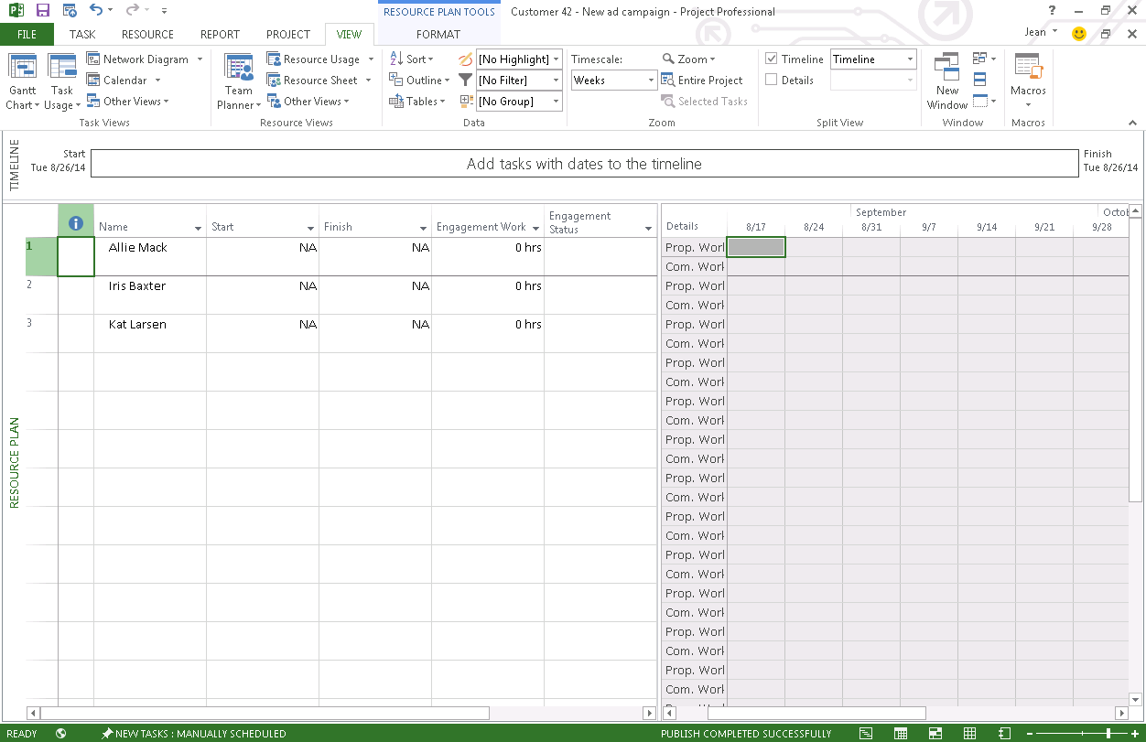
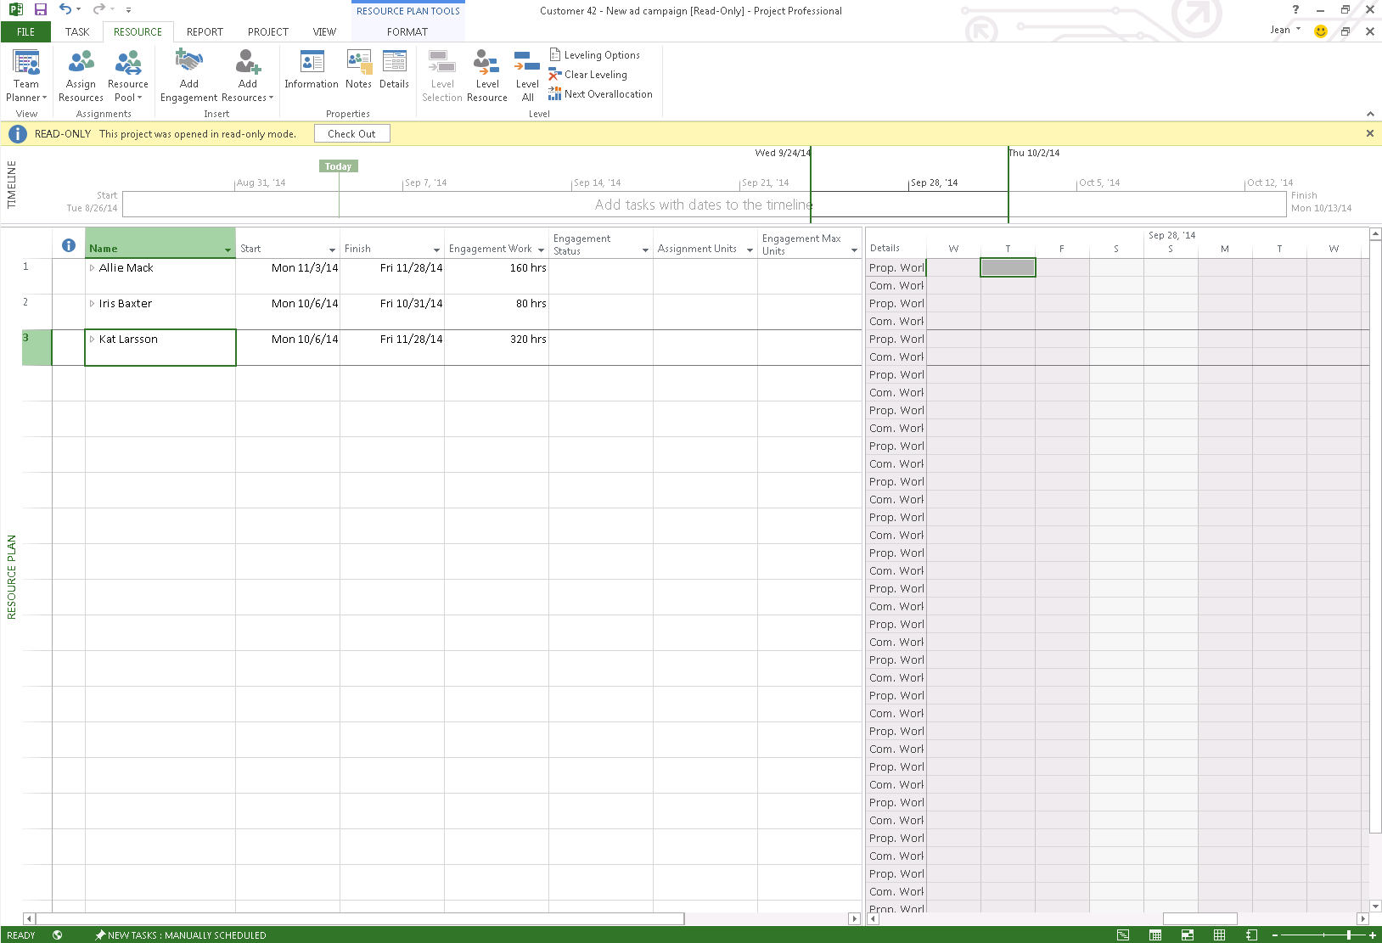
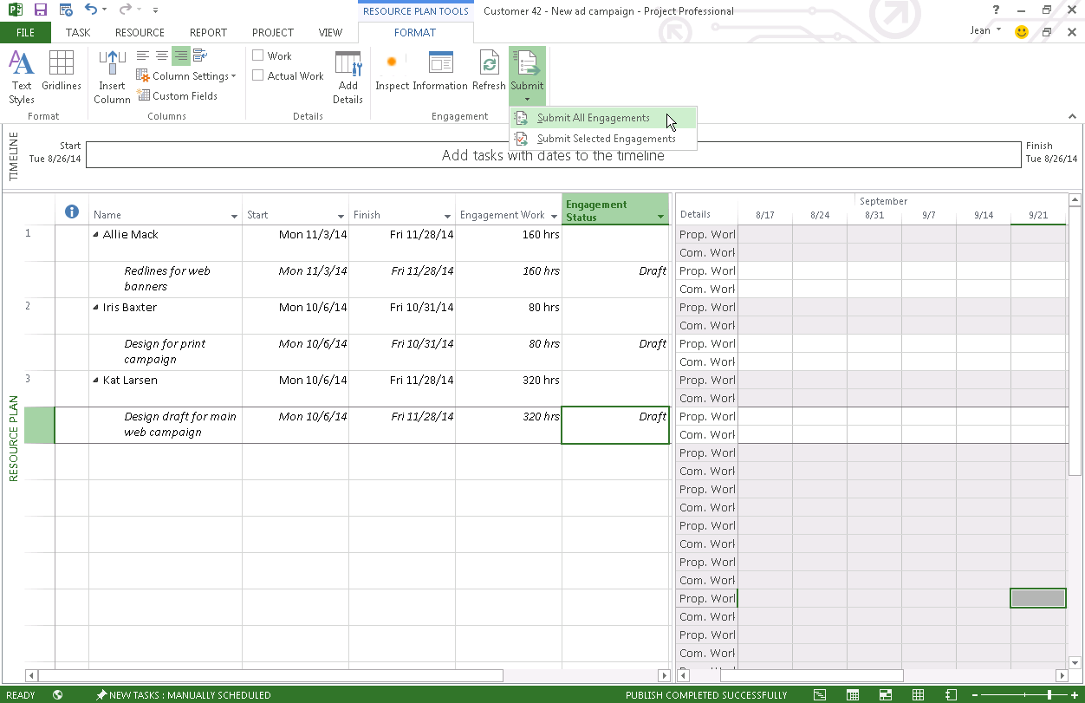
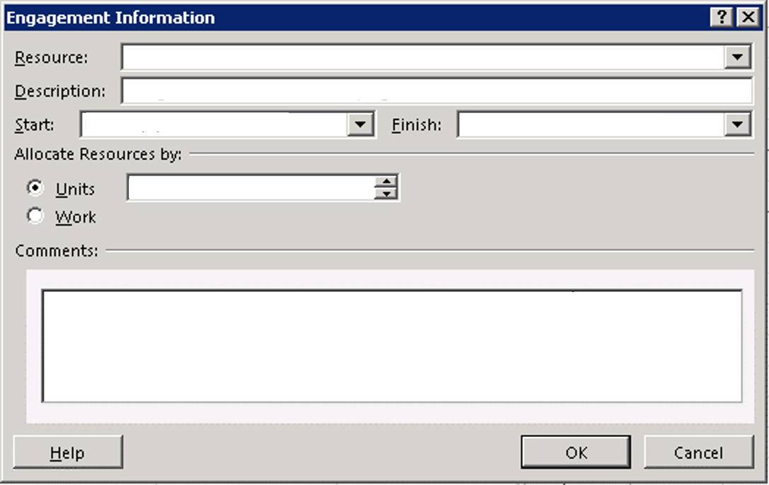
Resource Management
Intuitive interface to enter details and submit request
Contoso Design – New Ad Campaign – Project Professional
Designer
Design for script outline
Developer
Mon 10/6/2014
Fri 11/28/2014
Copywriter
Resource Engagement
Designer
100%
Jean 10/1/14 1:31PM: I really need Kat for this project. Let me know if she is available

Slide 18
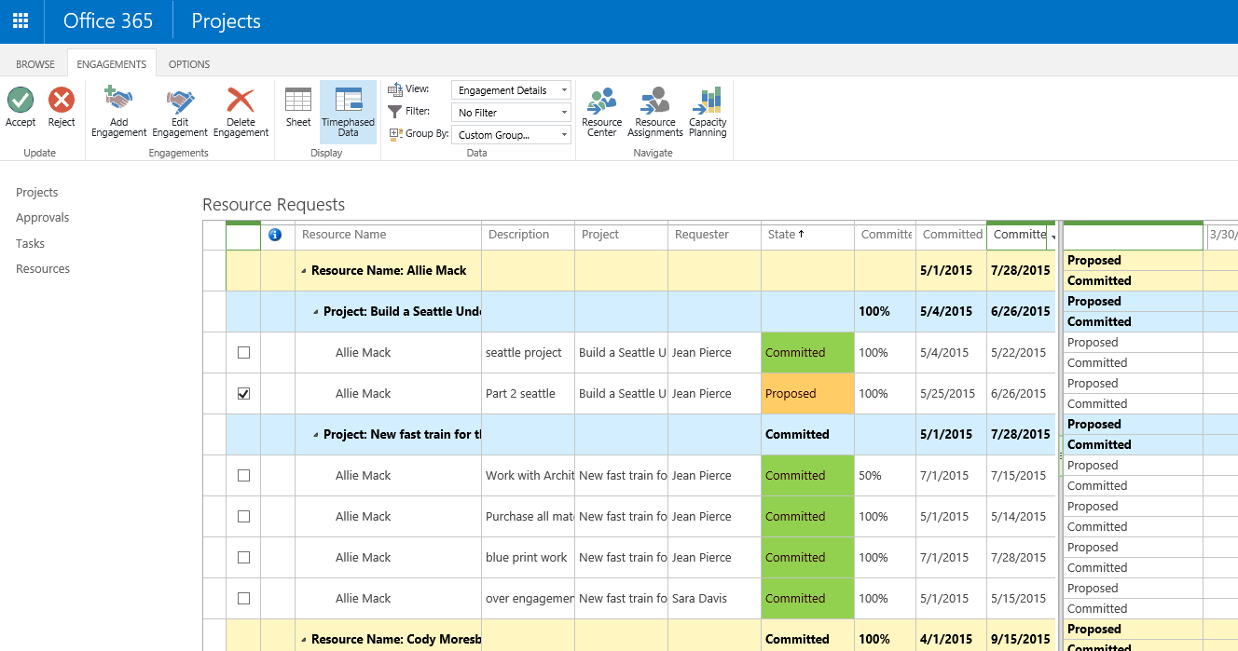
Resource Management
Intuitive Interface to Approve/Reject requests
Resource Engagement

Slide 19
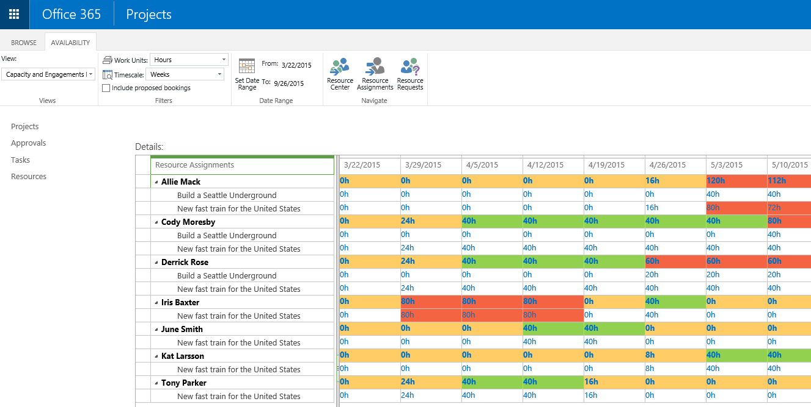
Resource Management
Color coding lets you identify discrepancies
Capacity Planning

Slide 20

IT Value
Project

Slide 21
Enterprise Focus
SharePoint Online
PWA
Project Online
WCF Services
Project Server Interface (PSI)
Project Server Queuing System
Local Event Handlers
Project Server Eventing System
Business Objects
Infrastructure Consolidation
Project Calculation Service
Project Server Workflow System
Project Database
Content (+Project) Database
Content Database
Configuration Database

Slide 22
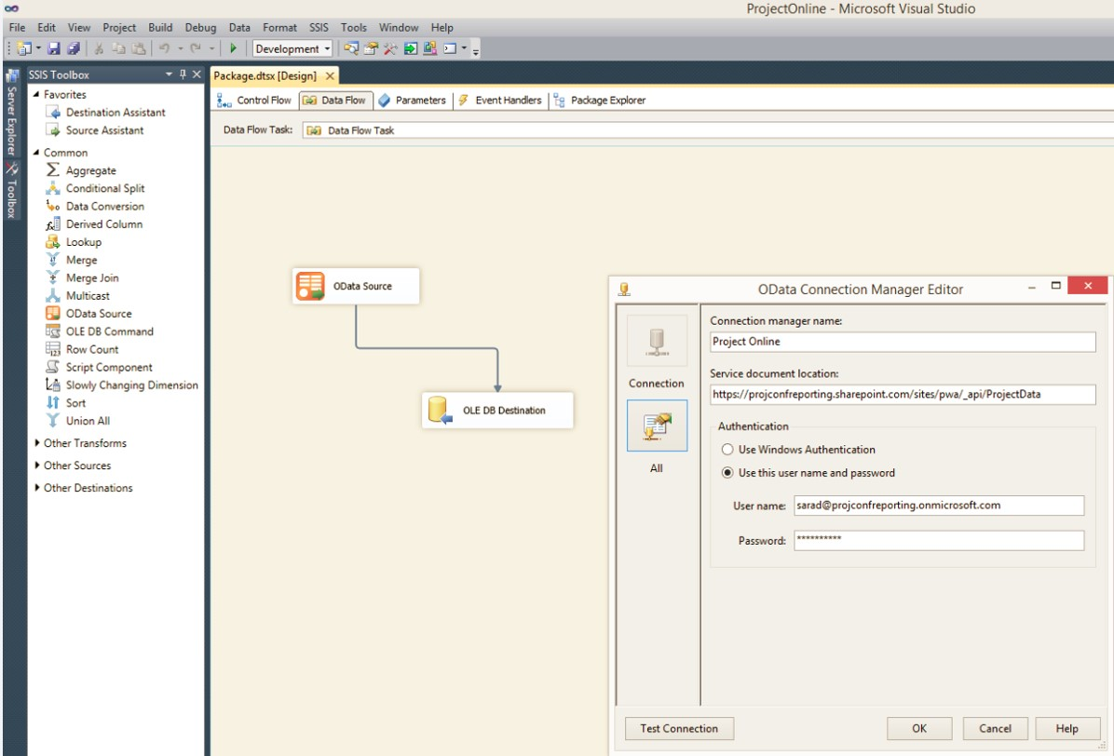
Enterprise Focus
OData available as a new standard data source in the SSIS Toolbox
Authenticate by specifying appropriate Project Online self-service OData URL and Project Online credentials
Enterprise
Reporting

Slide 23
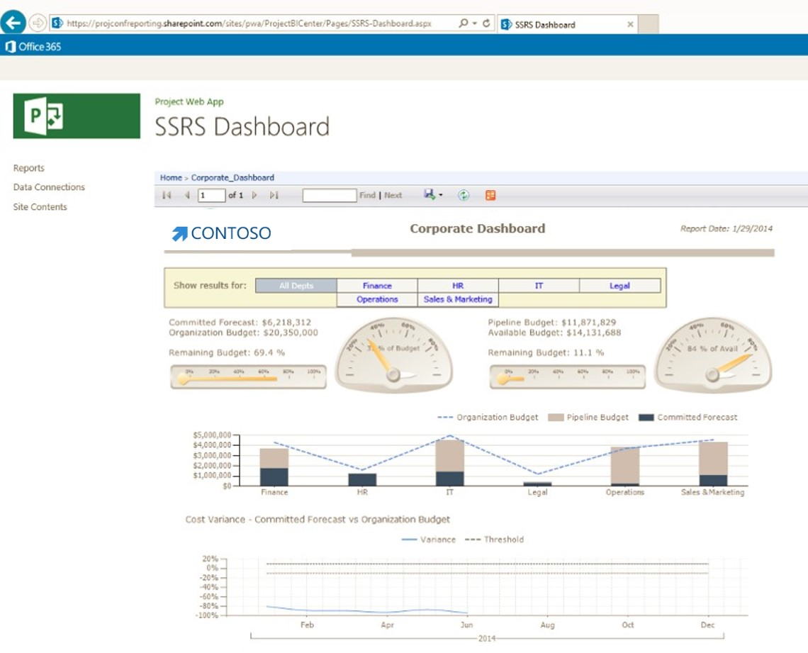
Enterprise Focus
Enterprise
Reporting

Slide 24
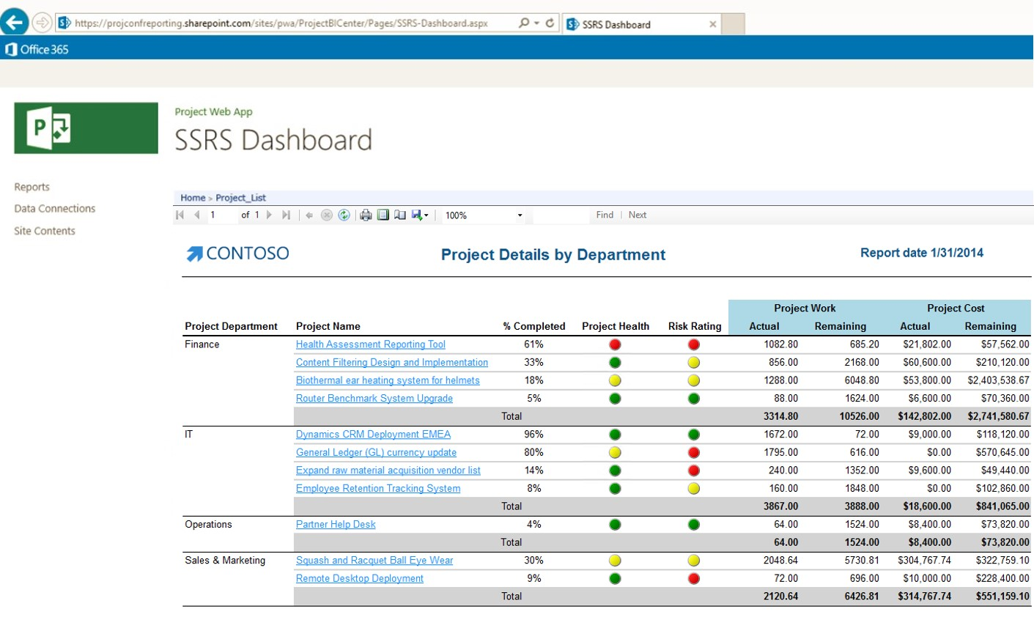
Enterprise Focus
Enterprise
Reporting

Slide 25
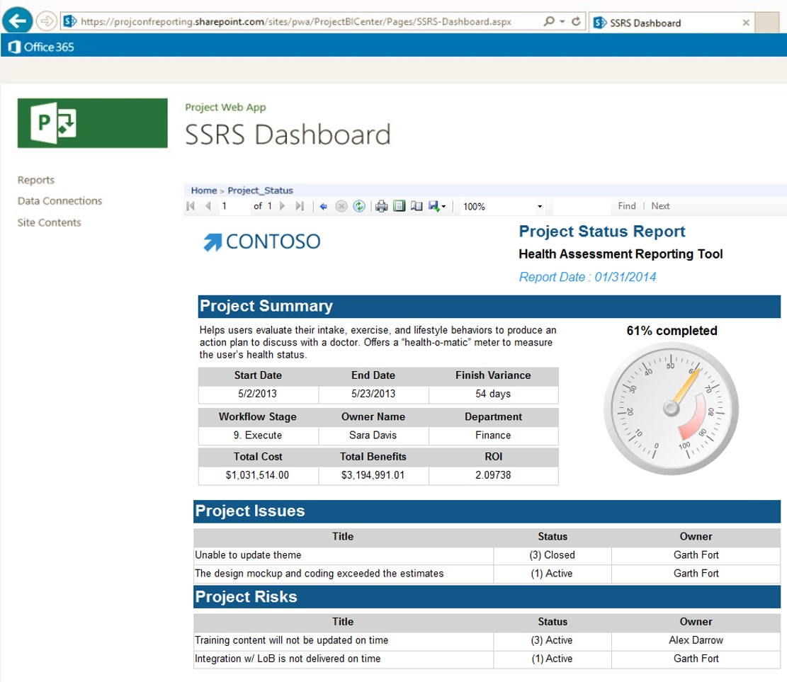
Enterprise Focus
Enterprise
Reporting

Slide 26
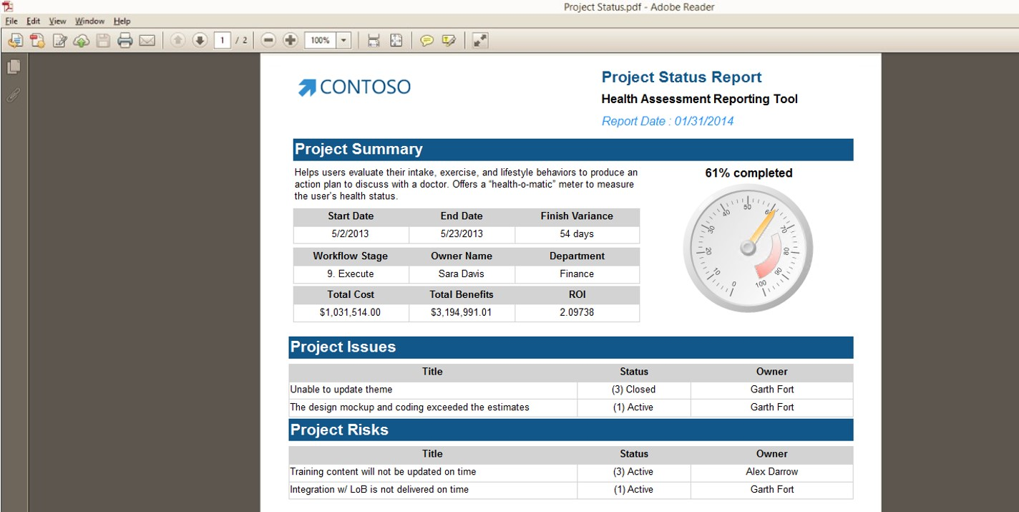
Enterprise Focus
Enterprise
Reporting

Slide 27
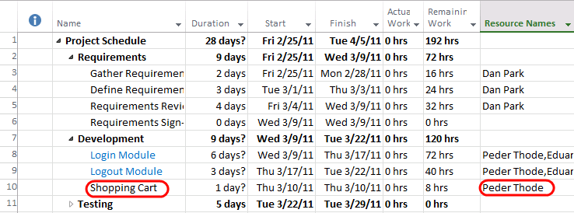
PM adds a new “Shopping Cart” feature to Project Plan in Project Professional.
Integration with Visual Studio Team Foundation Server
Screenshot from Project Professional

Slide 28
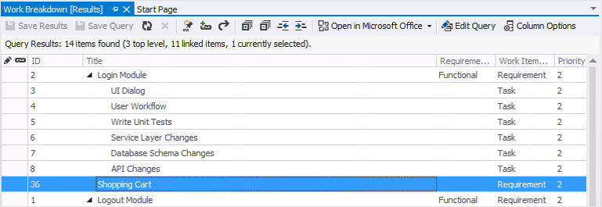
Dev manager notices the new requirement appear in Team Foundation Server.
Integration with Visual Studio Team Foundation Server
Screenshot from Visual Studio Team Foundation Server

Slide 29
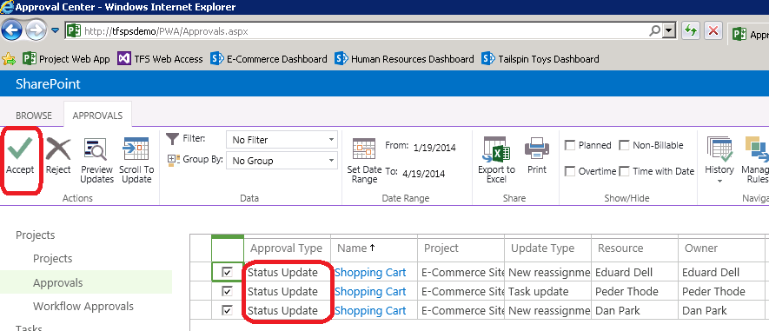
PM approves all the change request in Project Web App.
Integration with Visual Studio Team Foundation Server
Screenshot from Project Server

Slide 30

Big Data
Project

Slide 31
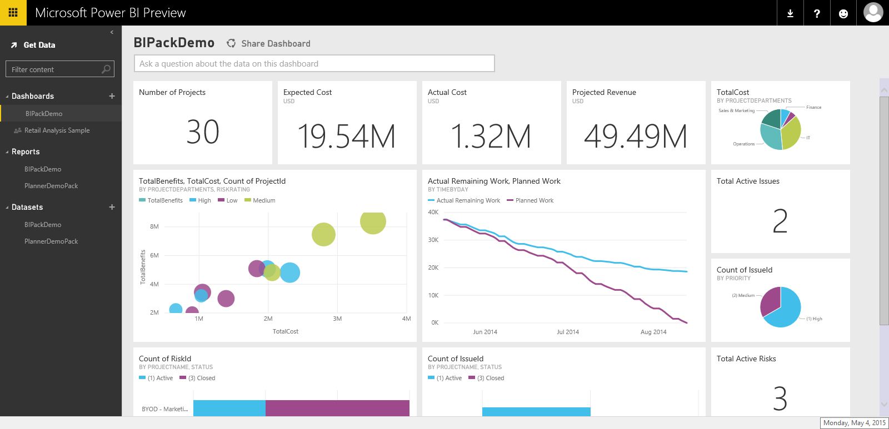
PowerBI.com

Slide 32
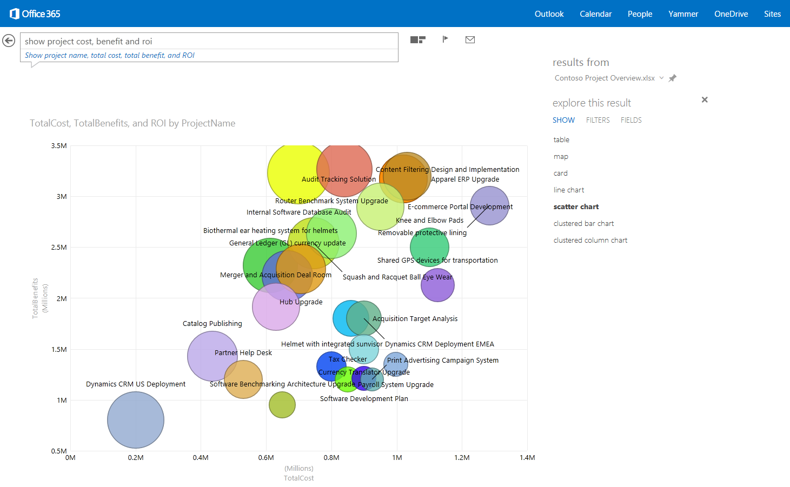
PowerBI.com

Slide 33
Demo: Roadmap de Project

Slide 34
Q&A

